Slide 1
Chemical Properties of Metals

Slide 2
By the end of this lesson, you should be able to:
Describe how metal atoms become metal ions.
Determine how reactive a metal is by using the activity series.
Discuss how a metal's position on the activity series can determine how it is used.

Slide 3

The chemical properties of metals are the properties that allow metals to form new substances through chemical reactions.

Slide 4
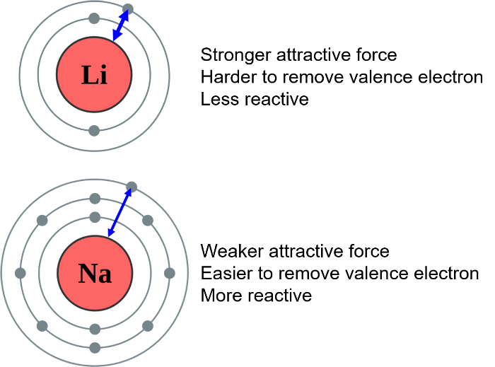
A common feature of metals is that they have a small number of outer-shell or valence electrons.
These electrons are loosely held and can be lost easily. More reactive metals will lose electrons more easily than less reactive metals.

Slide 5
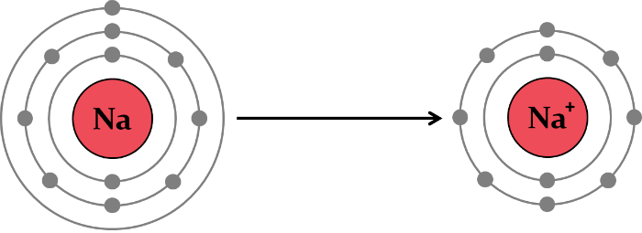
When metal atoms lose their valence electrons they will have fewer electrons (-) than protons (+) and therefore have an overall positive charge.
These positively charged metal ions are called cations. The cation that is formed will have a positive charge equal to the number of electrons lost.

Slide 6
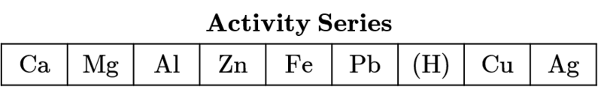
Activity Series
Different metals will react differently with oxygen, water and dilute acids. This is determined by how easily they lose electrons and form cations.
By observing these reactions, metals can be arranged into a list from most reactive to least reactive. This list is called the activity series.

Slide 7
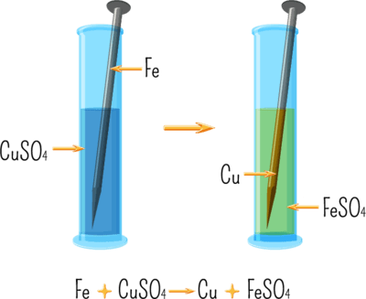
Displacement Reactions
Metal displacement reactions are when one metal displaces another metal in a compound.
For example, when an iron nail is placed in a solution of blue copper sulfate, the blue liquid will eventually turn green and the nail will be coated with a brown solid.
These changes occur because the iron displaces the copper in the solution, forming iron sulfate and copper metal.

Slide 8
Metals that are more reactive will displace metals that are less reactive from their compounds. In the earlier example of iron in copper sulfate, the iron displaced copper because iron is more reactive than copper.
However, if iron was placed in a solution of zinc sulfate, no reaction would occur because iron is less reactive than zinc.

Slide 9
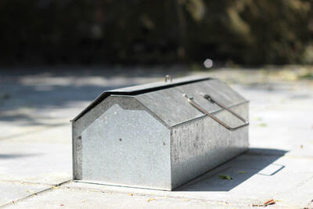
Sacrificial metals are more reactive metals that are used to protect less reactive metals.
Galvanisation is an example of zinc protecting steel (iron). Zinc is more reactive than iron, so when iron is coated in zinc the zinc will react first and prevent the iron from rusting. In this example, zinc is acting as a sacrificial metal.

